Slide 1
Welcome to
Instructional strategies TO IMPROVE STUDENT LEARNING WORKSHOP

Slide 2
you can Follow my blog at
Christiansforever.com

Slide 3
About the presenter
Faith Sheptoski-Forbush is a veteran school teacher, reading specialist, author and blog writer with a master’s degree in reading
Faith, together with her family, enjoys wholesome entertainment, travel and outdoor recreation

Slide 4

develop your child’s learning skills
What are some ways to do this?

Slide 5
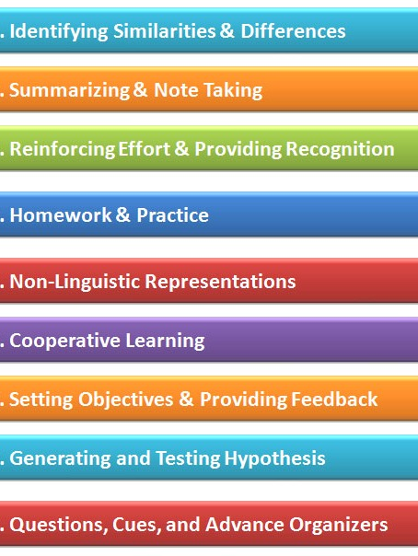
What is one of the best ways to do this?
One way is to use Marzano’s Nine High-Yield Instructional Strategies

Slide 6
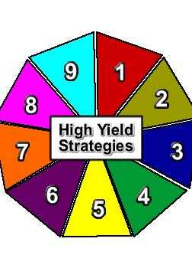
This is accomplished by using one strategy at a time
Start by putting one foot in front of the other

Slide 7
1st strategy: identifying similarities and differences
This strategy yields a 45 percentile gain in student achievement
Students should compare, classify, and create metaphors, analogies, and non-linguistic or graphic representations

Slide 8
How it looks in the learning environment
Thinking Maps, T-Charts, Venn Diagrams, Classifying, Cause and Effect Links, Compare and Contrast Organizers
QAR (Question/Answer/Relationship), Sketch to Stretch, Affinity Diagrams, and Frayer Model

Slide 9
What are thinking maps?
There are eight types of graphic organizers
There are eight diagram types that correspond with eight different fundamental thinking processes
They provide a common visual language to information structure that are used when students take notes

Slide 10
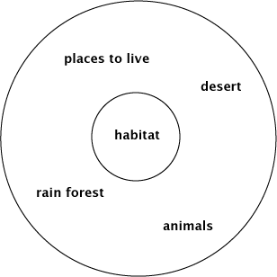
thinking maps - 1
The Circle Map is used for defining in context

Slide 11
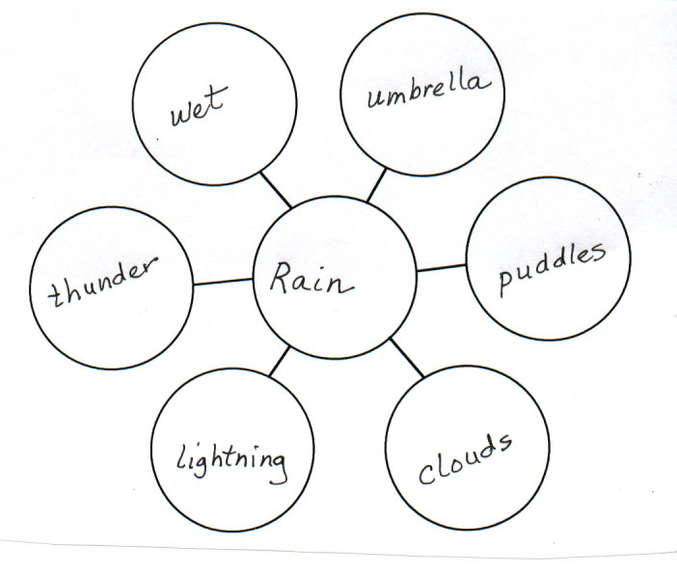
thinking maps - 2
The Bubble Map is used for describing with adjectives

Slide 12
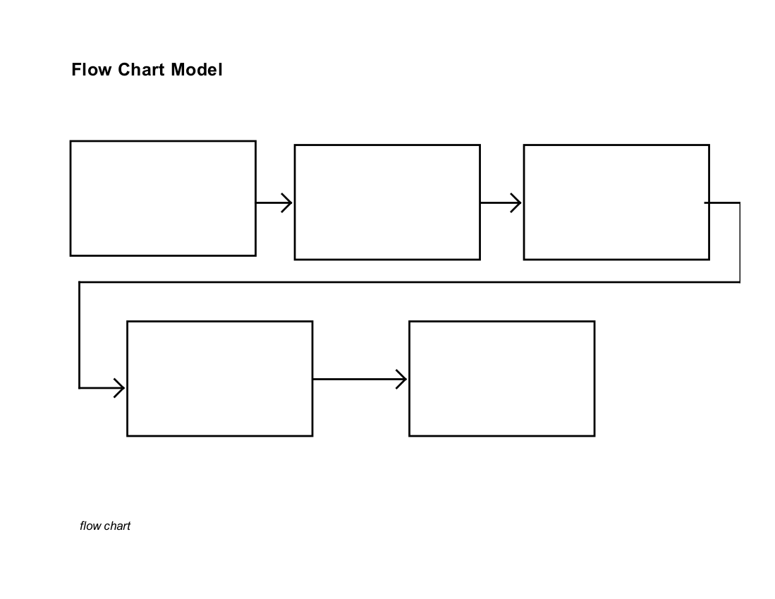
thinking maps - 3
The Flow Map is used for sequencing and ordering events

Slide 13
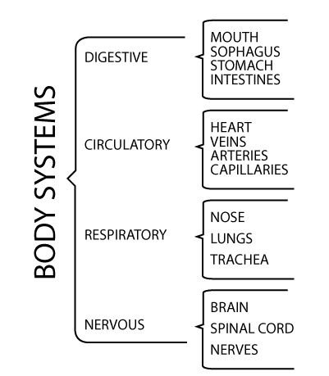
thinking maps - 4
The Brace Map is used for identifying part/whole relationships

Slide 14
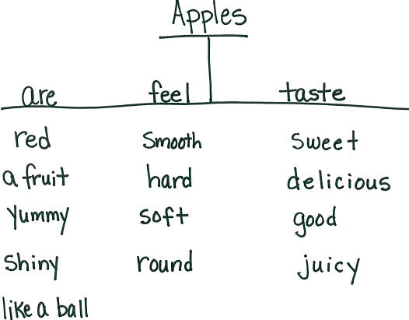
thinking maps - 5
The Tree Map is used for classifying or grouping

Slide 15
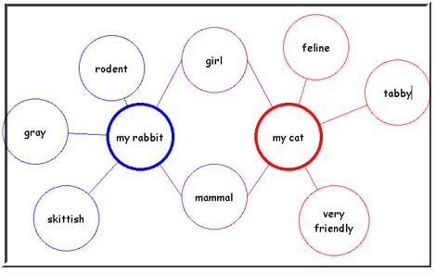
thinking maps - 6
The Double Bubble Map is used for comparing and contrasting

Slide 16
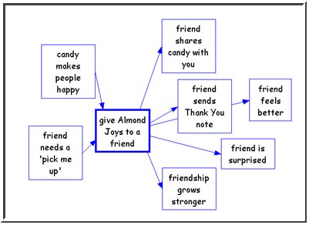
thinking maps - 7
The Multi-Flow Map is used for analyzing causes and effects

Slide 17
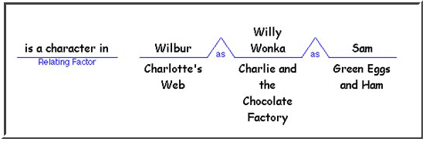
thinking maps - 8
The Bridge Map is used for illustrating analogies

Slide 18
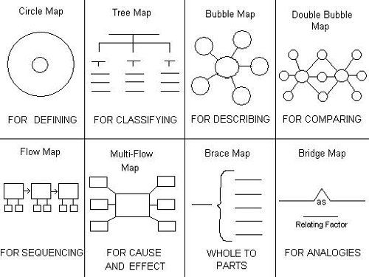
thinking maps in summary

Slide 19
2nd strategy: summarizing and note taking
This strategy yields a 34 percentile gain in student achievement
Students should learn to eliminate unnecessary information, substitute information, and keep important information

Slide 20
2nd strategy: summarizing and note taking
Students should also write/rewrite, and analyze information
Students should be encouraged to put some information into their own words

Slide 21
How it looks in the learning environment
Educator Models, Summarization Techniques, Identify Key Concepts, Bullets, Outlines, Clusters, Narrative Organizers, Journal Summaries, Break-Down Assignments
Quick Writes, Graphic Organizers, Column Notes, Affinity Diagram

Slide 22

Summarizing strategy
This strategy includes instructing your child to read 5-10 sentences in the Bible out loud
After each sentence is read, ask your child to verbally summarize each sentence in his own words

Slide 23

Summarizing strategy
Another strategy is to assign your child to silently read 5-10 sentences in the Bible
Next instruct your child to write a summary of each sentence

Slide 24
Summarizing strategy
When your child summarizes a sentence, he gives a condensed version of what he just read
In the summary, he refers to the author’s key ideas

Slide 25
3rd strategy: reinforcing efforts & providing recognition
This strategy yields a 29 percentile gain in student achievement
Homeschooler should reward based on standards of performance; use symbolic recognition along with tangible rewards

Slide 26

How it looks in the learning environment
Hold High Expectations, Display Finished Products, Praise of Student Effort, Encourage Student to Share Ideas and Express Their Thoughts, Honor Learning Style
Conference With Student, Authentic Portfolio, Stress-Free Environment, High-Fives, Spelling Bee, Constitution Day, Newspaper

Slide 27
4th strategy: Homework & Practice
This strategy yields a 28 percentile gain in student achievement
Homeschooler should vary the amount of work based on student grade level, state purpose of assignment

Slide 28
How it looks in the learning environment
Retell, Recite, and Review Daily Learning, Reflective Journals, Write Goals and Objectives
Grade Level Teamwork, Email

Slide 29
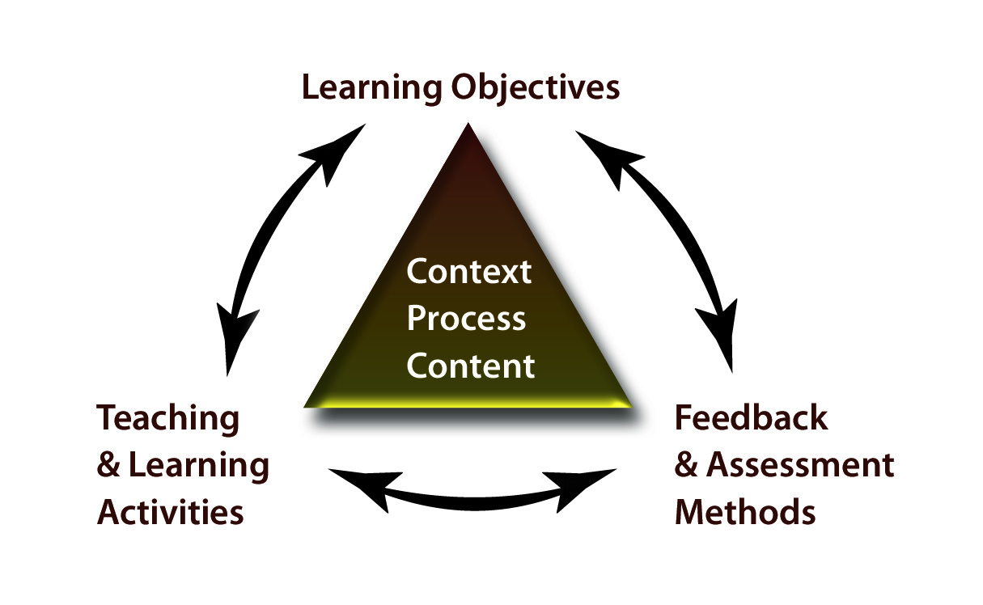
How it looks in the learning environment

Slide 30
5th strategy: nonlinguistic representations
This strategy yields a 27 percentile gain in student achievement
Students should create graphic representation, models, mental pictures, drawings, pictographs, and participate in kinesthetic (hands-on) activities in order to assimilate knowledge

Slide 31
How it looks In the learning environment
Visual Tools and Manipulatives, Problem-Solving Organizers, Spider Webs, Concept Maps, Drawings, Charts
Thinking Maps, Graphic Organizers, Sketch-to-Stretch, Storyboards, Foldables, Act-Out-Content, Make Physical Models

Slide 32
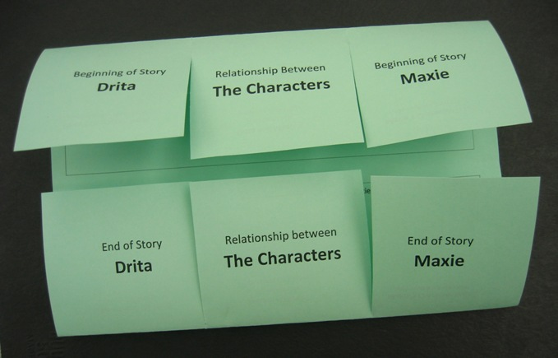
How it looks in the learning environment

Slide 33
6th Strategy: cooperative learning
This strategy yields a 23 percentile gain in student achievement
Homeschooler should assign roles and responsibilities in groups

Slide 34
How this looks in the learning environment
Integrate Content and Language Through Group Engagement, Reader’s Theatre, Pass-the-Pencil, Circle-of-Friends, Cube-It, Radio Reading
Integrate Shared Reading and Writing, Plays, Jigsaw, Group Reports

Slide 35
how this looks in the learning environment
Choral Reading, Affinity Diagrams, Students Tackle Word Problems in Groups & Explain Their Answers

Slide 36
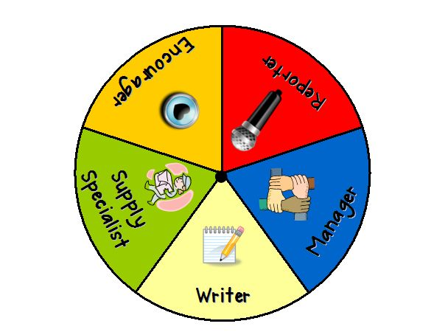
How it looks in the learning environment

Slide 37
7th Strategy: setting objectives and providing feedback
This strategy yields a 23 percentile gain in student achievement
Homeschooler should create specific and flexible goals
Feedback should be corrective, timely and specific to criterion

Slide 38
how this looks in the learning environment
Articulating and Displaying Learning Goals, KWL, Contract Learning Goals
Homeschooler displays objectives/outcomes on the board with follow-up of mastery of the objectives/outcomes

Slide 39
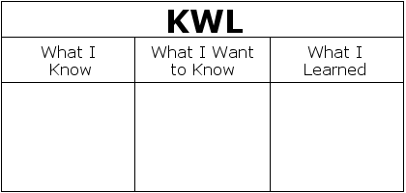
how this looks in the learning environment

Slide 40
8th Strategy: generating and testing hypothesis
This strategy yields a 23 percentile gain in student achievement

Slide 41
8th Strategy: generating and testing hypothesis
Students should generate, explain, test, and defend hypotheses using both inductive and deductive strategies
This is done through problem solving, history investigation, invention, experimental inquiry, and decision making

Slide 42
How this looks in the learning environment
Thinking Processes, Constructivist Practices, Investigate, Explore, Social Construction of Knowledge, Use of Inductive and Deductive Reasoning, Questioning the Author of a Book
Finding Other Ways to Solve Same Math Problem

Slide 43
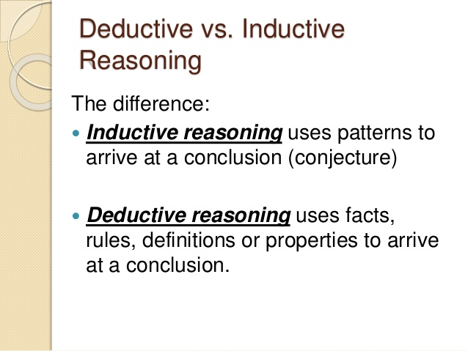
how this looks in the learning environment

Slide 44
9th Strategy: questions, cues and advance organizers
This strategy yields 22 percentile gain in student achievement
Homeschoolers should use cues and questions that focus on what is important, use ample wait time for responses, inferences and analysis

Slide 45
9th Strategy: questions, cues and advance organizers
Homeschoolers should use advance organizers to focus on what is important and most useful with information that is not well organized

Slide 46
How it looks in the learning environment
Graphic Organizers, Provide Guiding Questions Before Each Lesson, Think-Alouds, Inferencing, Predicting
Drawing Conclusions, Skim Chapters to Identify Vocabulary, Concepts and Skills, Foldables, Annotating the Text

Slide 47
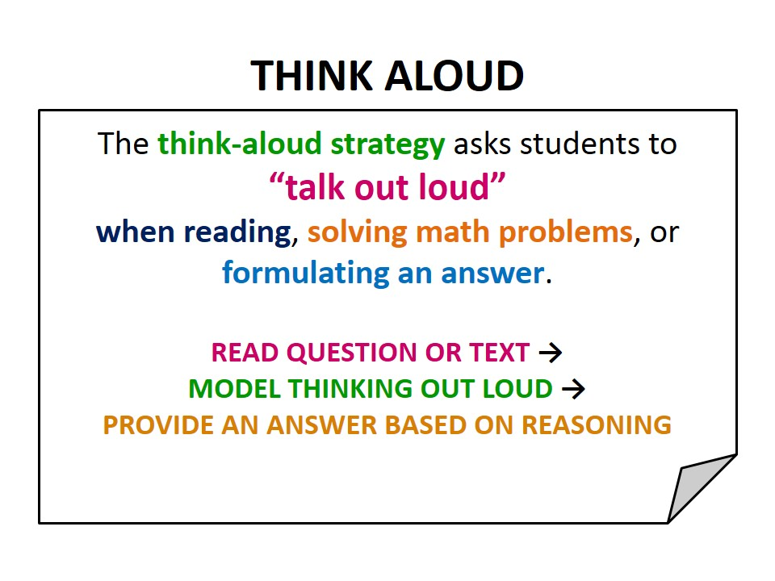
how this looks in the learning environment

Slide 48
Improving student learning is accomplished by using one strategy at a time
Start by putting one foot in front of the other

Slide 49
Content area expectations
Go to the Michigan Department of Education website - called Michigan.gov to find out the specific content area expectations
The link is http://www.michigan.gov/mde/0,4615,7-140-28753_64839_65510---,00.html

Slide 50

Content area expectations
Look at the GLCEs
This is the Grade Level Content Expectations

Slide 51
Content area expectations
Look for the word “Standards” for each grade level
Next scroll down to click on each of the subject areas, such as math, science, social studies, etc., to find out the accepted standard of mastery

Slide 52
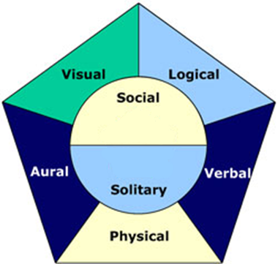
Seven Learning styles

Slide 53
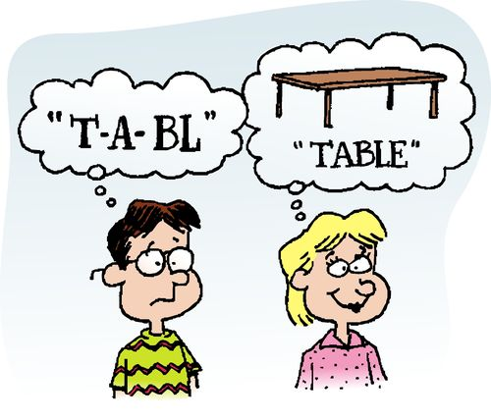
Visual (spatial)
You prefer using pictures, images, and spatial understanding

Slide 54
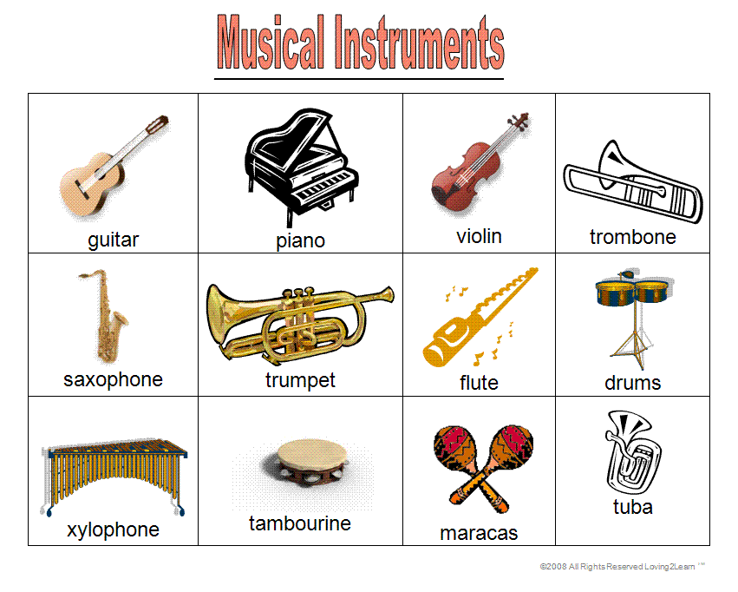
Aural (Auditory-Musical)
You prefer using sound and music

Slide 55

Verbal (linguistic)
You prefer using words, both in speech and writing

Slide 56
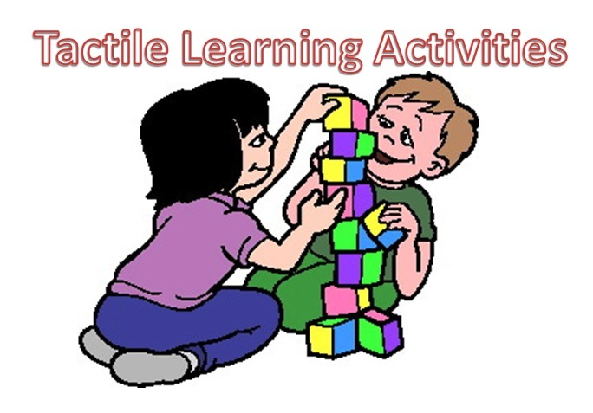
Physical (kinesthetic)
You prefer using your body, hands and sense of touch

Slide 57
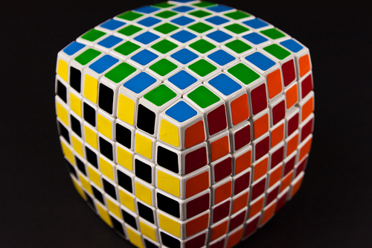
Logical (mathematical)
You prefer using logic, reasoning and systems

Slide 58

Social (interpersonal)
You prefer to learn in groups or with other people

Slide 59
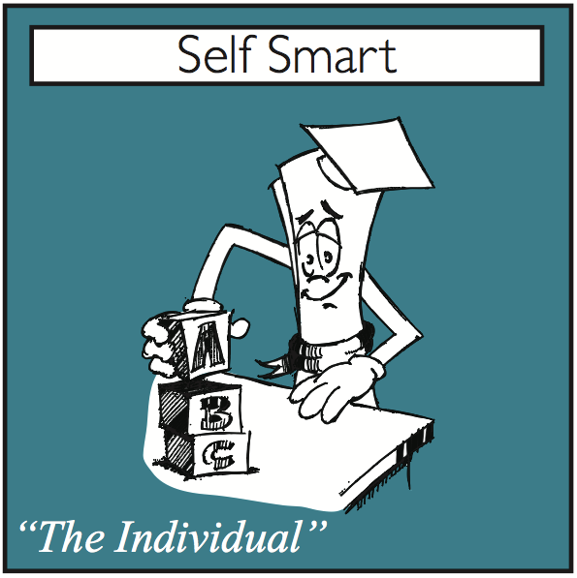
Solitary (intrapersonal)
You prefer to work alone and use self-study

Slide 60
Use the best techniques for learning
By recognizing and understanding your child’s learning styles, you can use some of the best techniques for learning
This improves the speed and quality of your child’s learning

Slide 61
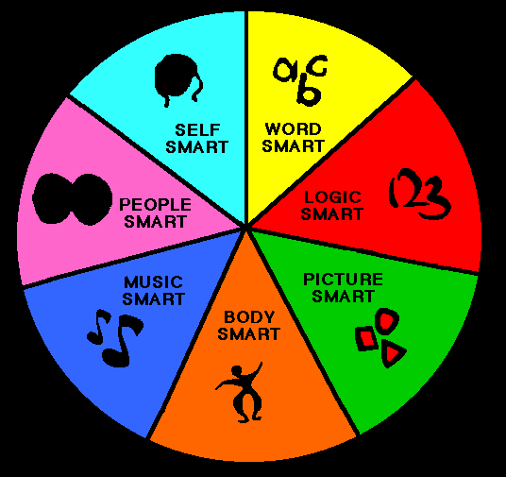
Seven Learning styles

Slide 62

develop your child’s reading skills
My book, Learning to Read: New Testament Stories, will help your child develop his reading skills

Slide 63

FURTHER develop your child’s reading skills
By using Learning to Read: New Testament Stories Study Guide

Slide 64

For Free educational resources
Follow us on Facebook and Twitter, or visit us at ChristiansForever.com

Slide 65

Thanks for coming

